Slide 1
Analysis of Human Connectomes
Sarah Kirby

Slide 2
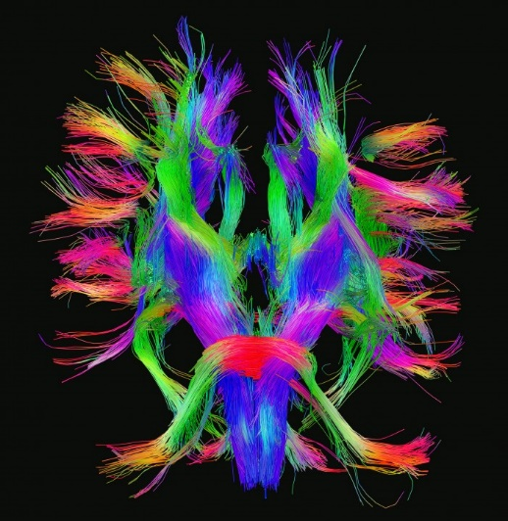
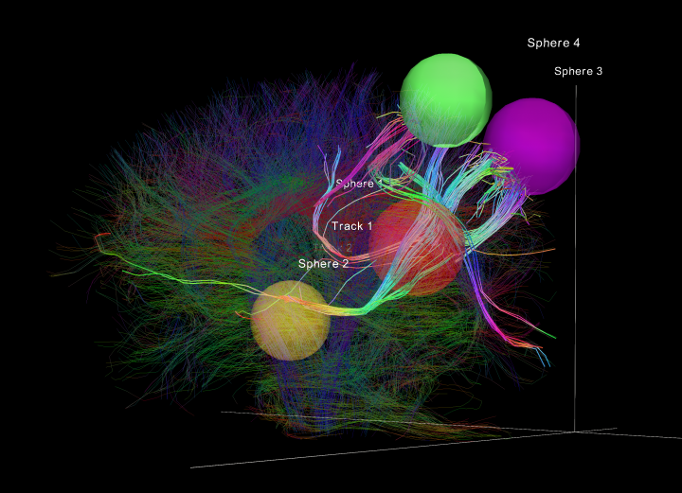
The Human Connectome Project
Aims to construct a complete map of the structural and functional neuronal connections in the human brain.
Connectome – a graph of the neuronal connections in the brain.
Mapped the connections between 1015 “anatomically identified gray matter areas,” also called Regions of Interest (ROIs).
Available in graphml via braingraph.org
http://www.humanconnectomeproject.org/
Notes:
The human connectome project…
Connectome…

Slide 3
Constructing Connectomes from MRIs
Each vertex corresponds to a small (1–1.5 cm²) area of gray matter (called Regions of Interest, ROIs)
Two vertices are connected by an edge if a “diffusion-MRI based workflow” finds fibers of axons running between those ROIs.
Direction is assigned to edges based on the hypothesis that the edges common to most individuals’ graphs were formed first, with newer edges growing towards older connections.

Slide 4
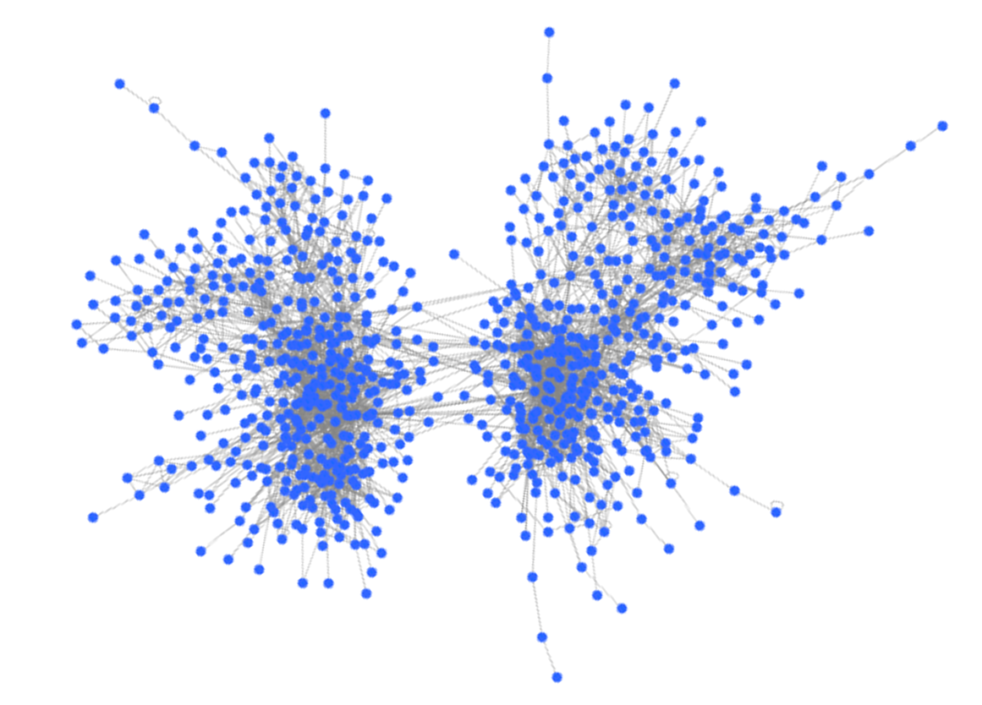
A Sample Connectome

Slide 5
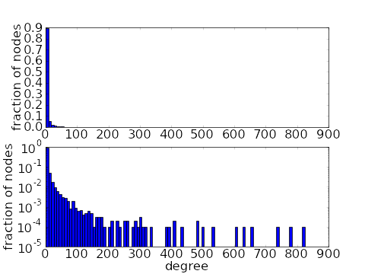
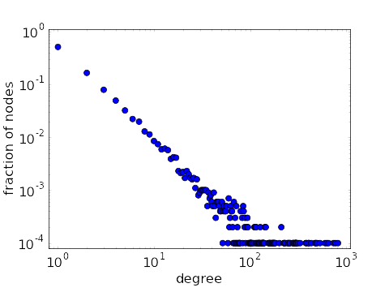
Are Connectomes Scale-Free?
Properties of scale-free graphs:
Degree distribution follows the power law.
Clustering coefficient distribution follows the power law.
Clustering coefficient distribution decreases as node degree increases.
https://mathinsight.org/scale_free_network

Slide 6
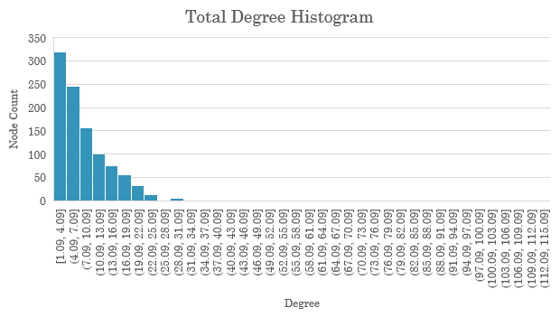
Connectome Degree Distributions: Total Degree
Total degree distribution (in degree + out degree) is not quite a power-law distribution.

Slide 7
Total Degree By Hemisphere
Left and right hemisphere both have the same total degree distribution as the full network.

Slide 8
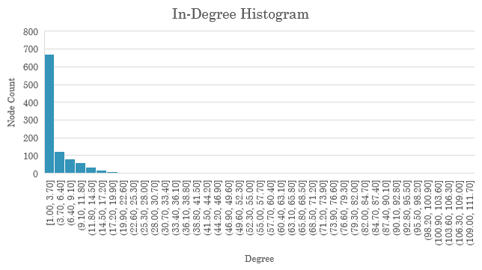
In-Degree Distribution
In-degree distribution is very close to a power-law distribution.

Slide 9
In-Degree By Hemisphere
Left and right hemisphere have the same in-degree distribution as the full network.

Slide 10
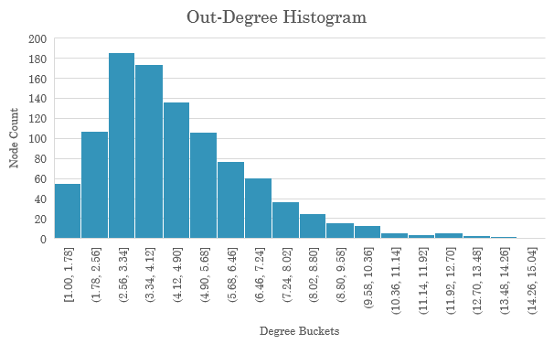
Out-Degree Distribution
Out-degree does not follow a power-law distribution.

Slide 11
Out-Degree By Hemisphere
Left and right hemisphere have the same out-degree distribution.

Slide 12
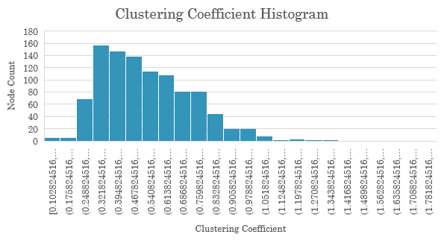
Clustering Coefficient Distribution
Clustering coefficient does not follow a power-law distribution.

Slide 13
Clustering Coefficient By Hemisphere
Left and right hemisphere have the same clustering coefficient distribution.

Slide 14
Clustering Coefficient vs Degree
Clustering coefficient decreases as node degree increases.
Clustering coefficient has a power-law relationship with degree.
This is a property of the hierarchical scale-free model.

Slide 15

Are Connectomes Scale-Free?
Total degree distribution is not quite power-law.
Out-degree is not power-law
In-degree is close to power-law
Clustering coefficient distribution is not power-law.
Clustering coefficient decreases as node degree increases.
Clustering coefficient as a function of total degree is power-law.
Property of hierarchical scale-free graphs
Overall, the average connectome is not scale-free.

Slide 16
Are Connectomes Small-World?
Properties of small-world graphs:
Short average path lengths
High clustering
Small world metrics compare a random graph and lattice graph of equivalent size and average degree.
Generated with Cytoscape’s Randomizer plug-in
Property | Connectome 100307 | Random Graph, Preserving Degree | Lattice Graph
Avg Degree | 9.181 | 9.181 | 8
Avg Clustering (C) | 0.311 | 0.043 | 0.643
Avg Shortest Path (L) | 4.106 | 3.117 | 52.189

Slide 17
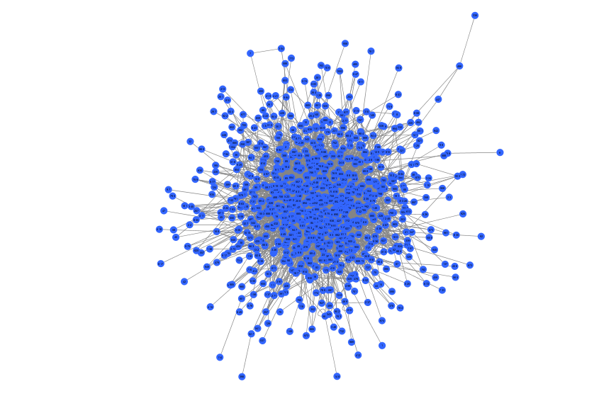
Randomized Connectome, Preserving Degree

Slide 18
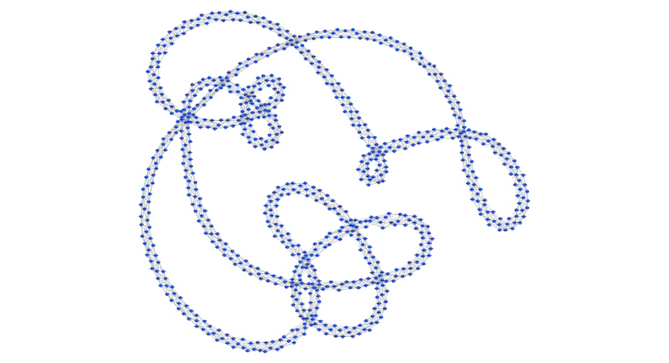
Lattice Graph

Slide 19
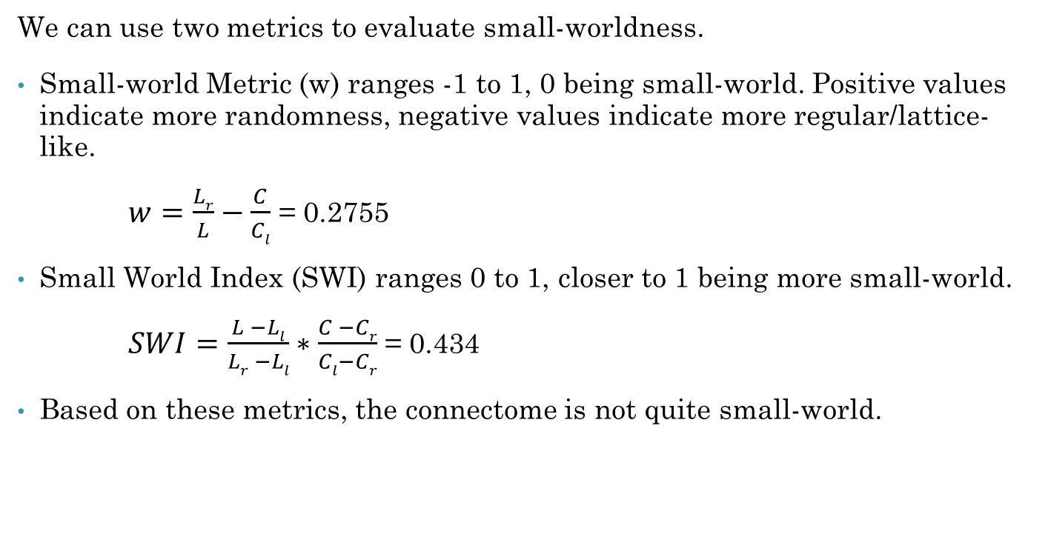
Are Connectomes Small-World?
We can use two metrics to evaluate small-worldness.
Small-world Metric (w) ranges -1 to 1, 0 being small-world. Positive values indicate more randomness, negative values indicate more regular/lattice-like.
$w=\frac{Lr}{L}−\frac{C}{Cl}$ = 0.2755
Small World Index (SWI) ranges 0 to 1, closer to 1 being more small-world.
$SWI=\frac{L −Ll}{Lr −Ll}∗\frac{C −Cr}{Cl−Cr}$ = 0.434
Based on these metrics, the connectome is not quite small-world.

Slide 20
Summary
Connectome properties do not fully align with scale-free network properties.
Small-world metrics do not indicate that the connectomes are small-world.
Caveat: The connectomes may not be representative of our true neuronal structures, since they only represent the connections between Regions of Interest (ROIs).

Slide 21
References
Connectome. Wikipedia. https://en.wikipedia.org/wiki/Connectome
The braingraph.org database of high resolution structural connectomes and the brain graph tools. https://www.ncbi.nlm.nih.gov/pmc/articles/PMC5637719/#CR6
How to Direct the Edges of the Connectomes: Dynamics of the Consensus Connectomes and the Development of the Connections in the Human Brain. https://www.ncbi.nlm.nih.gov/pmc/articles/PMC4928947/
Human. BrainGraph.org https://braingraph.org/cms/human/
The Human Connectome Project. http://www.humanconnectomeproject.org/
Scale-Free Network. Wikipedia. https://en.wikipedia.org/wiki/Scale-free_network
Scale-Free Networks. Math Insight. https://mathinsight.org/scale_free_network
Small-World Network. Wikipedia. https://en.wikipedia.org/wiki/Small-world_network
The Ubiquity of Small-World Networks. https://www.ncbi.nlm.nih.gov/pmc/articles/PMC3604768/

Slide 22
Connectome Averages
Averaged the measures for 6 pruned graphs (removed any nodes not connected to central component)
Property | Full Connectome Average | Left Connectome Average | Right Connectome Average
# Nodes | 876.4 | 439.6 | 435.2
Avg Degree | 9.415 | 9.2116 | 9.4588
Avg Clustering | 0.3058 | 0.3044 | 0.3112
Avg Shortest Path | 4.1198 | 3.4496 | 3.4064

Slide 23
Comparison to Random Graphs
Property | Connectome Average | Connectome 100307 | 100307 Randomized | 100307 Randomized, Preserving Degree | BA Generation (N=828, m=3) | Lattice Model
# Nodes | 1015 | 828 | 828 | 828 | 828 | 828
Avg Degree | 8.472 | 9.181 | 9.307 | 9.181 | 5.971 | 8
Avg Clustering (C) | 0.566 | 0.311 | 0.012 | 0.043 | 0.033 | 0.643
Avg Shortest Path (L) | 4.717 | 4.106 | 3.263 | 3.117 | 3.470 | 52.189

